Slide 1





Wetland Carbon Stocks Under Forest Canopy: GDA 599
Anthony J. Stewart¹, Meghan Halabisky¹, Chad Babcock², David Butman¹, David D'Amore³, L. Monika Moskal¹
¹University of Washington, ²University of Minnesota, ³USDA Forest Service
Thanks to Thomas Kakatsakis
Traditional Lands of the Hoh and Quinault Tribes

Slide 2
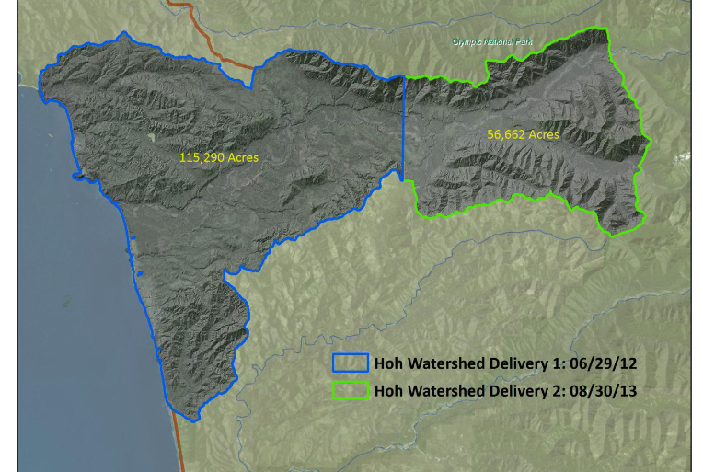


Background: Wetland Identification
LiDAR
Where does water pool?
Landscape pixels
Landscape pixels
National Wetland Inventory Training Data
Curve
TWI
LiDAR Digital Elevation Model
Slope
TWI
Dep
Curve
DEM Metrics:
Slope, Depression Area, Topographic Wetness Index
Random Forest
Algorithm*
Wetland/Upland
Hoh Watershed
Dr. Meghan Halabisky*

Slide 3
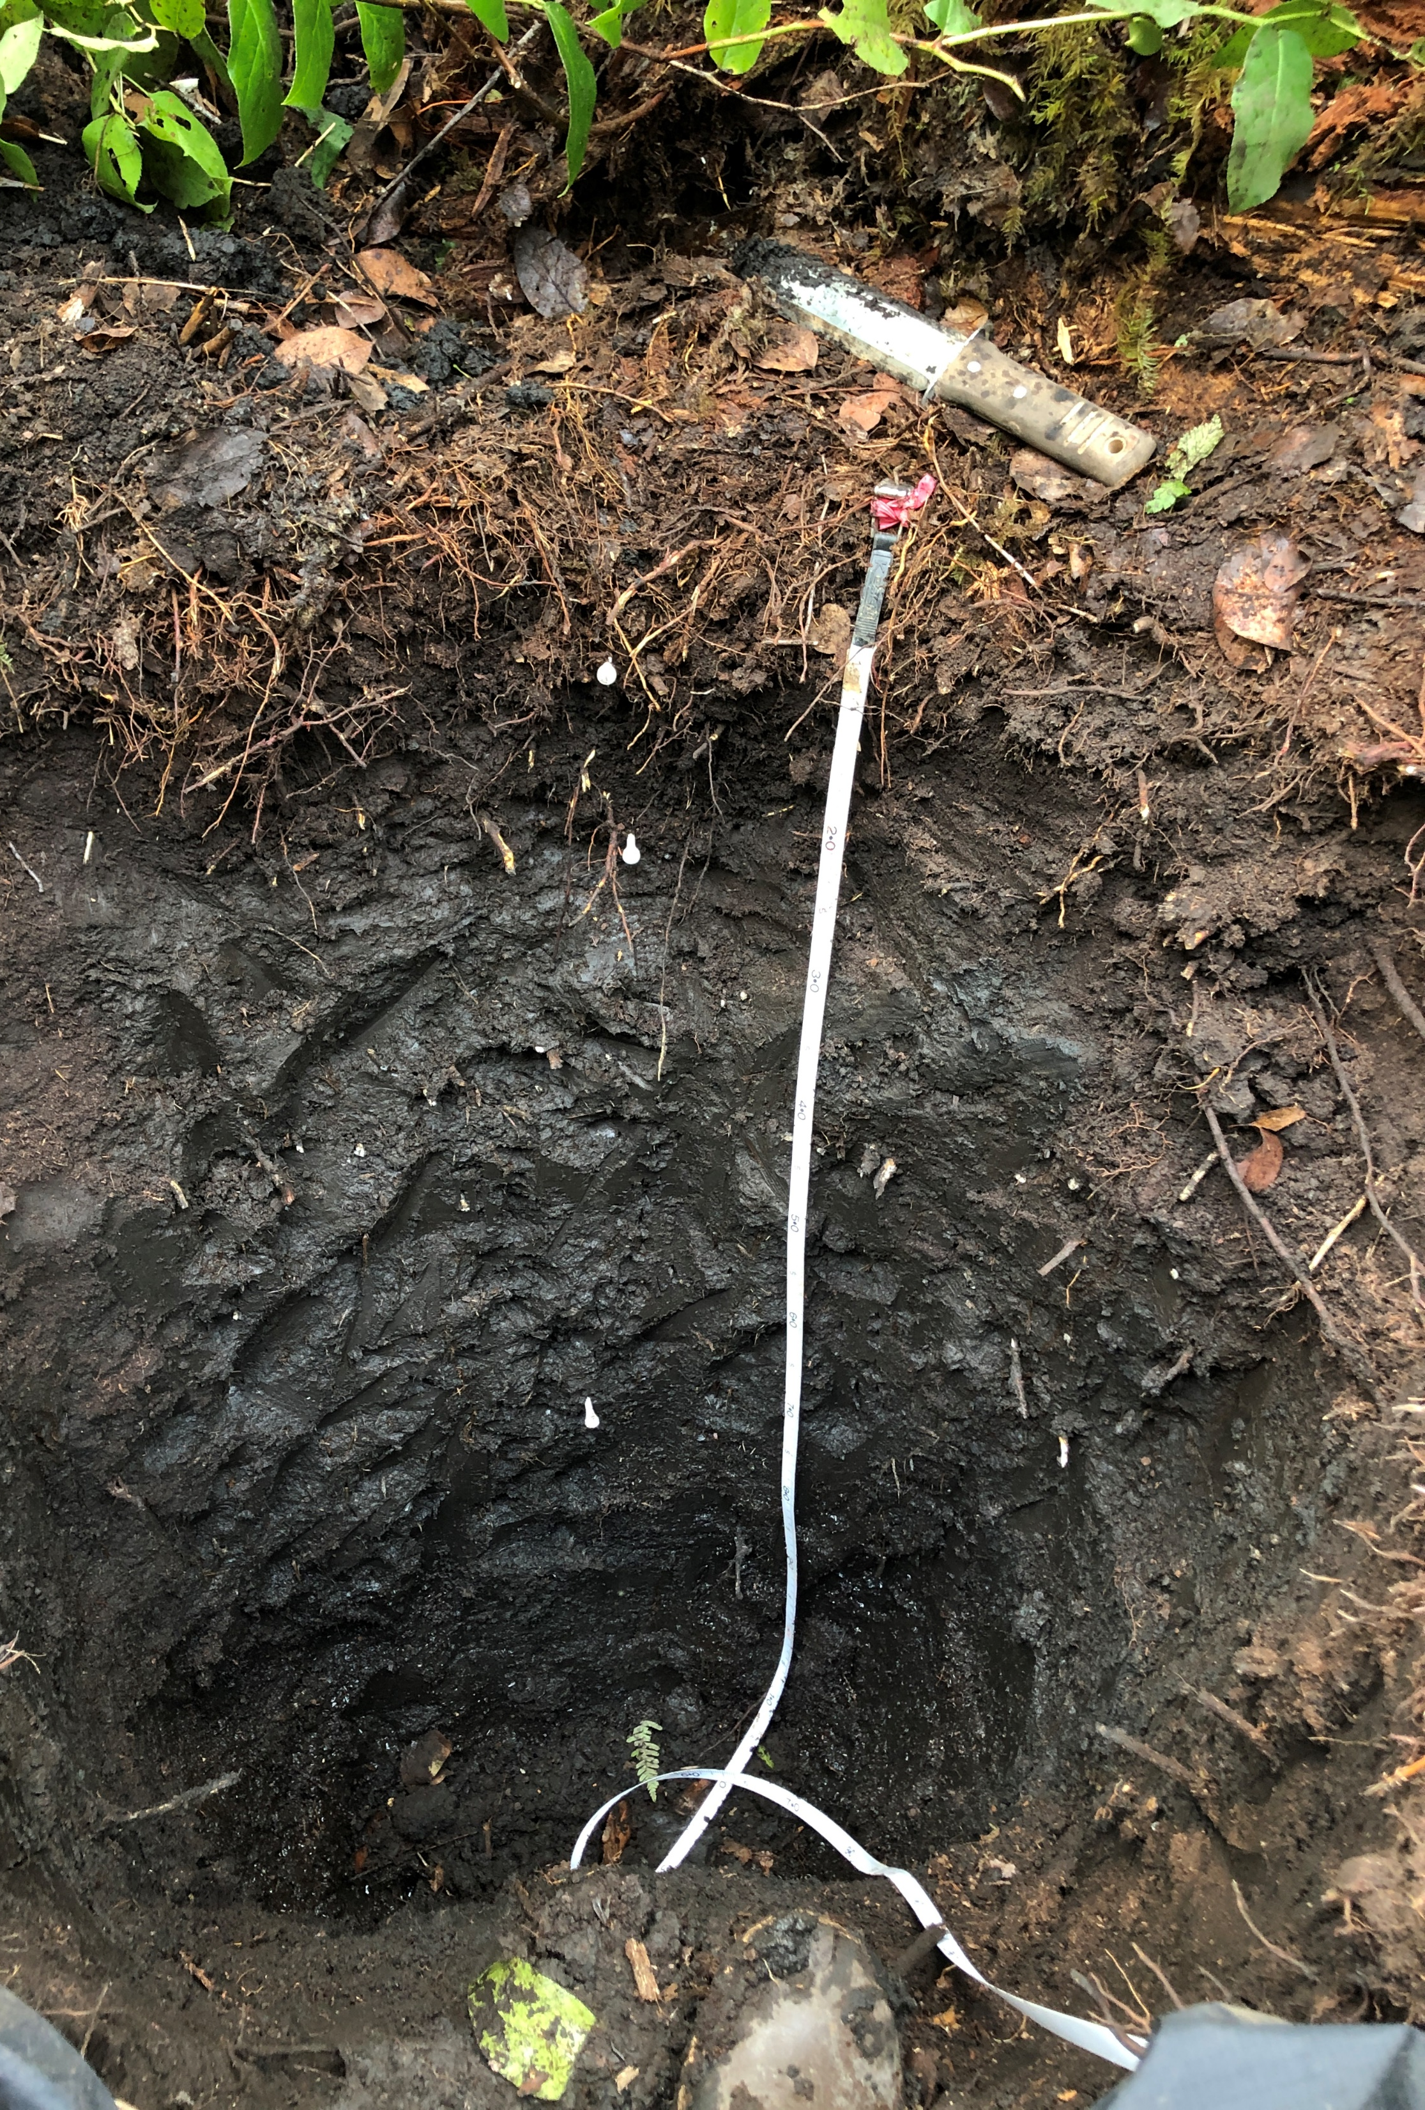
Wetland and their Carbon
Anoxic conditions from water saturation slow decomposition
Wetlands store 20-30% of global soil carbon despite occupying only 5-8% of the land surface

Slide 4
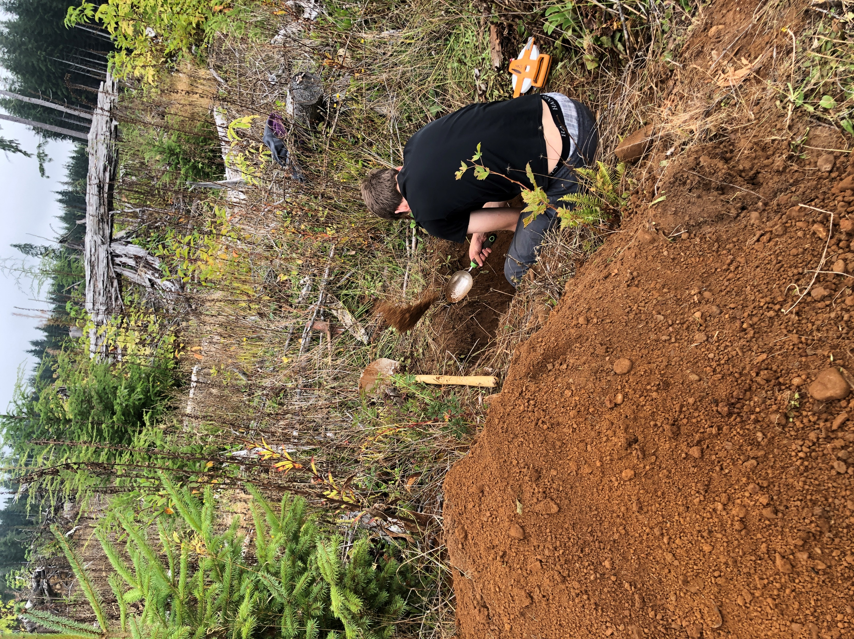
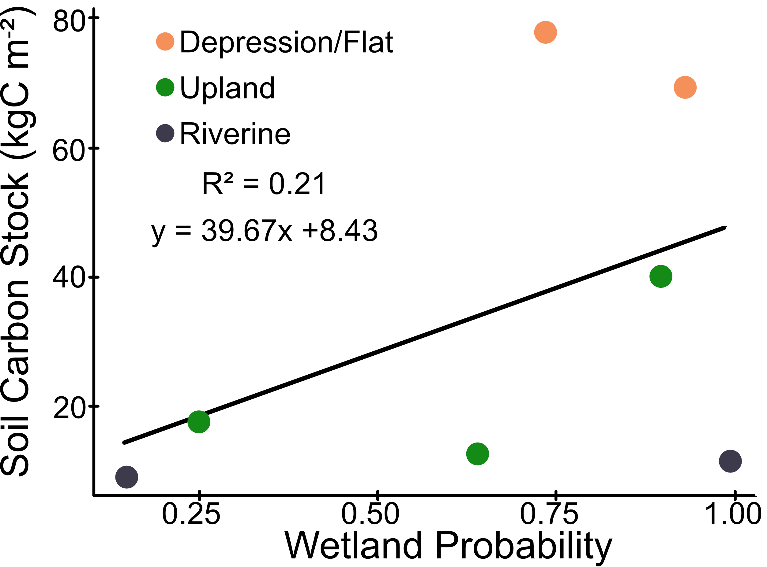
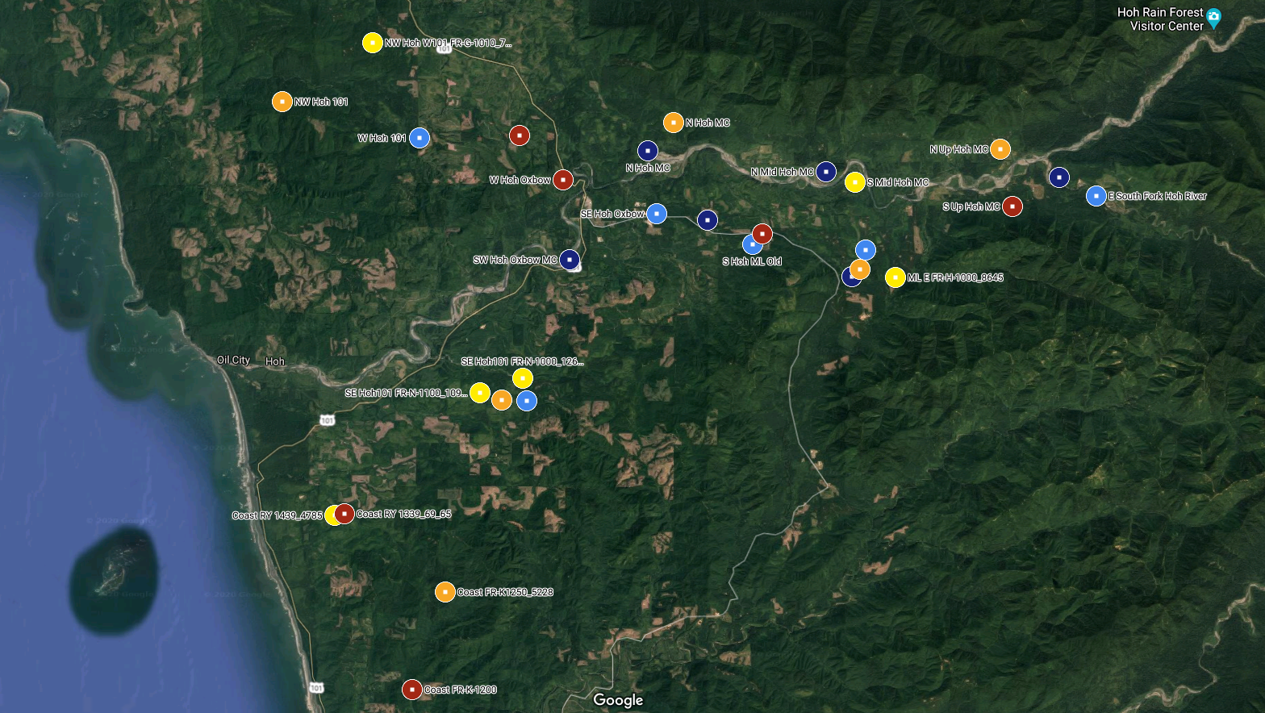
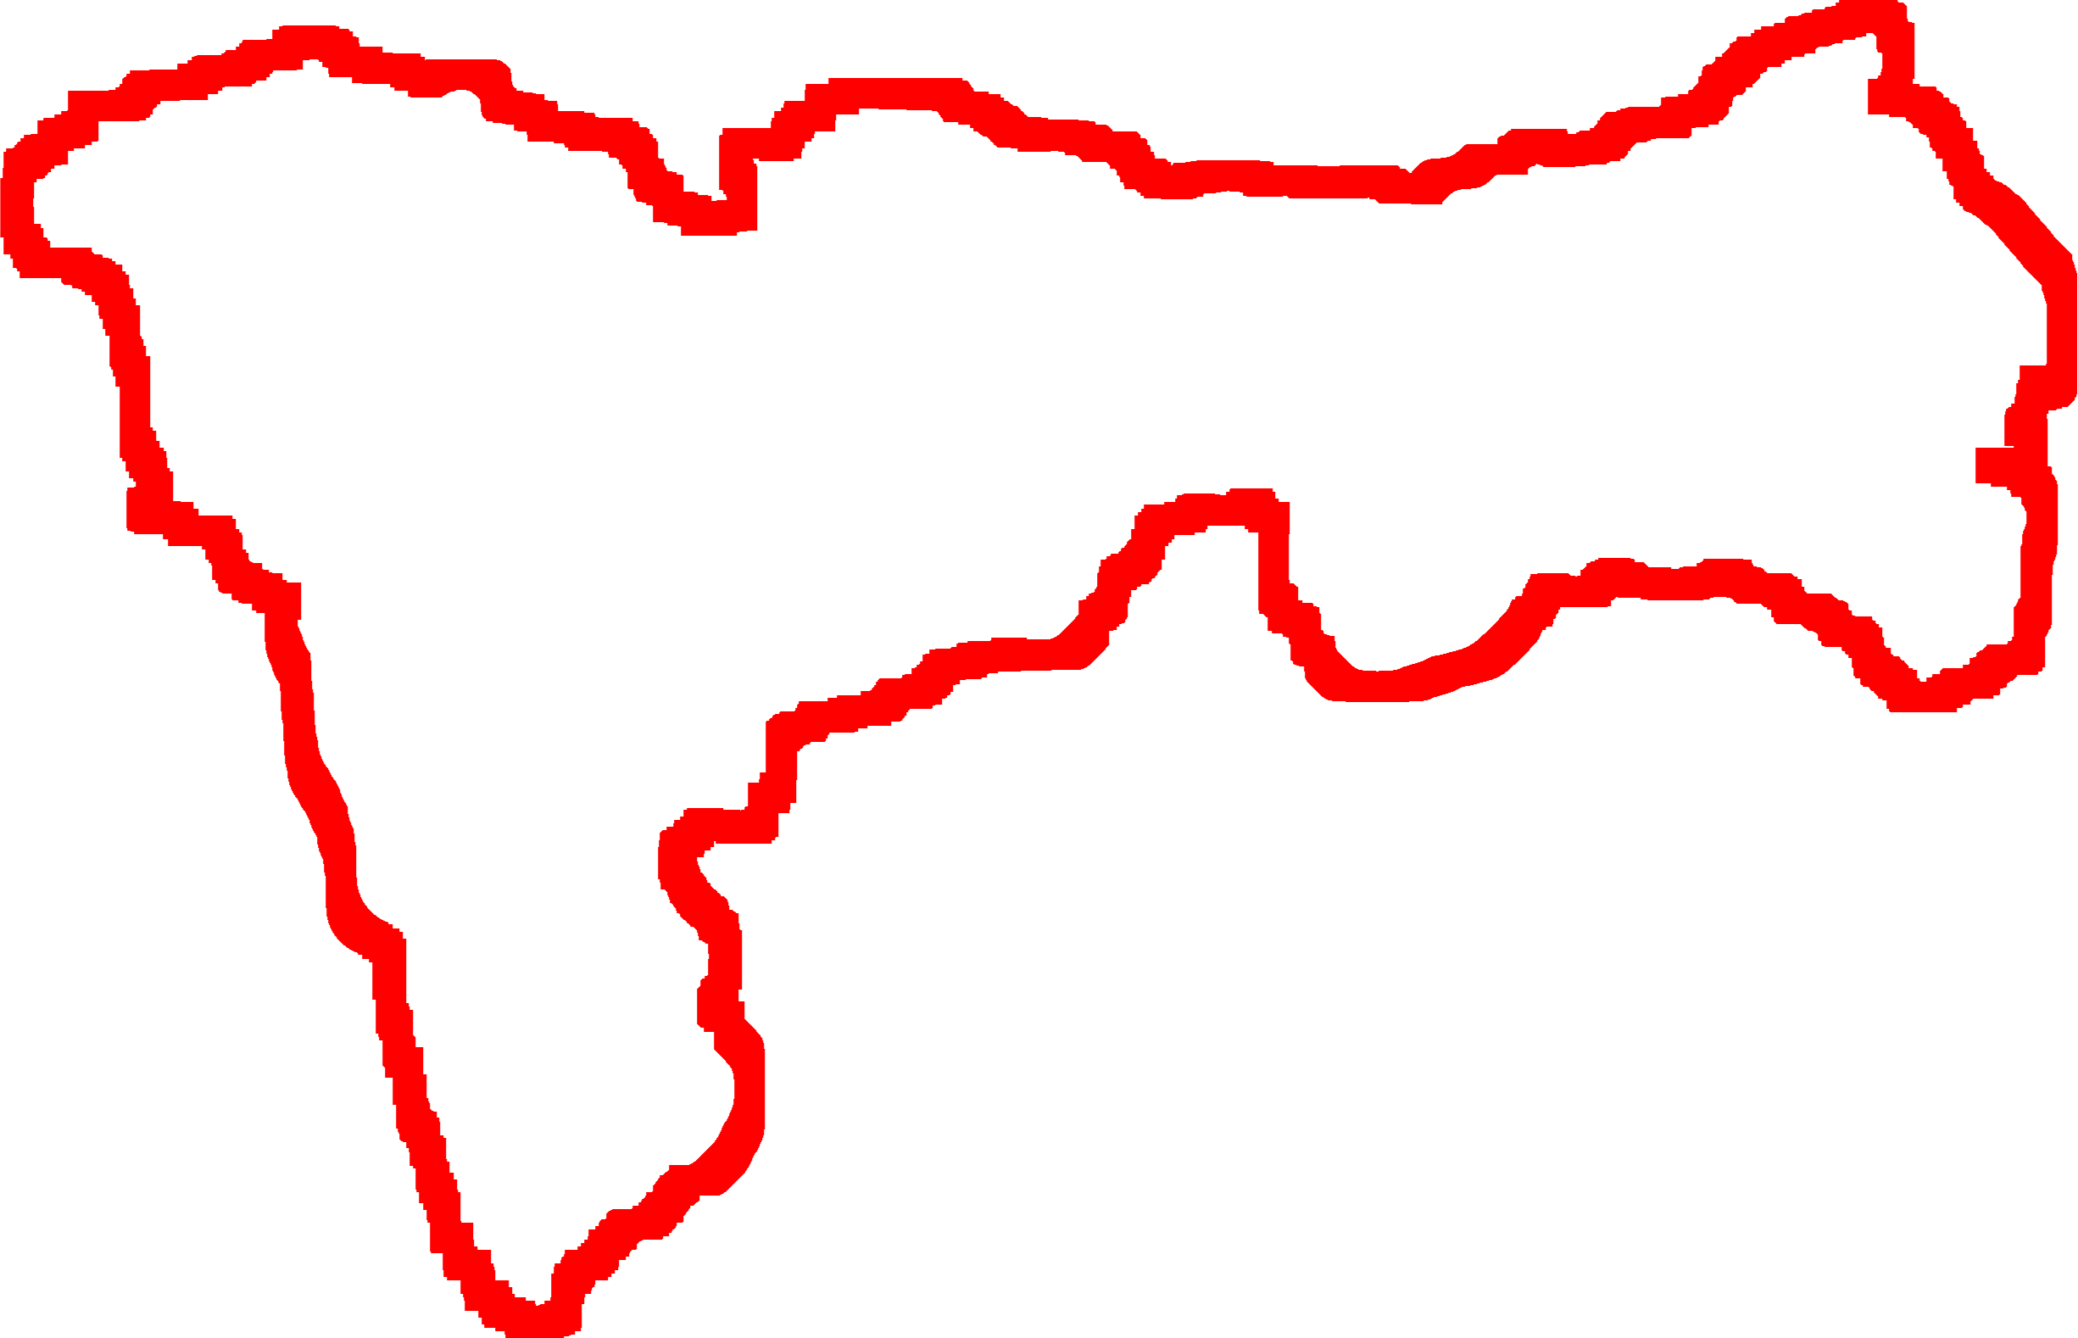
Background: Carbon Measurements
Thomas Kakatsakis
Hoh River Watershed
Objective: Apply these carbon stock measurements to the entire watershed

Slide 5
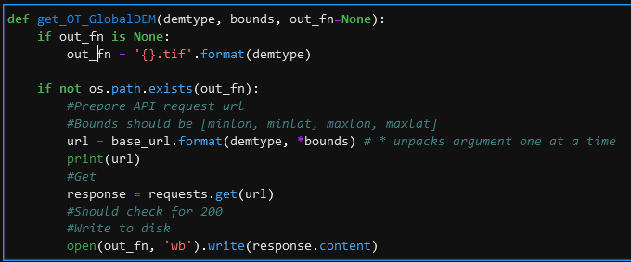
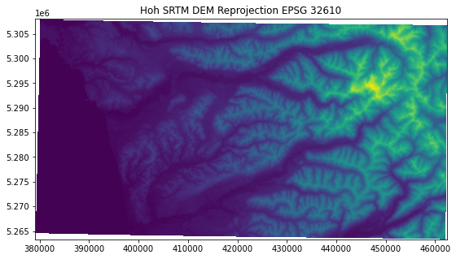
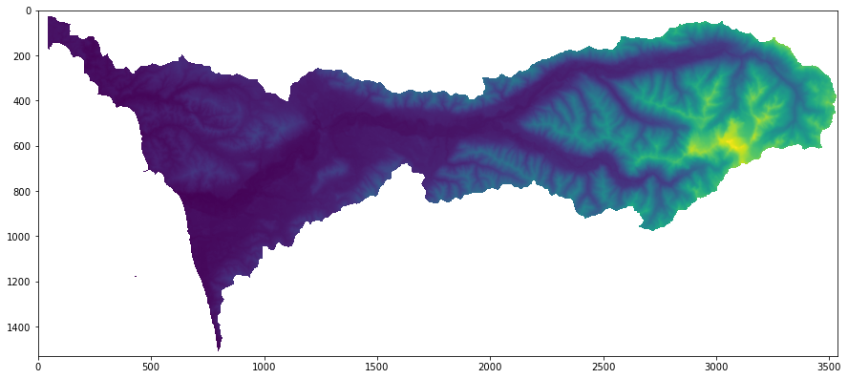
Methods
Data sources
SRTM 1 ArcSec (~30m) DEM
Use OpenTopography API to extract with bounds
Shapefile of Hoh Watershed from collaborator
Open Data with rasterio
Reproject to EPSG:32610
Clip to Hoh Watershed shapefile

Slide 6


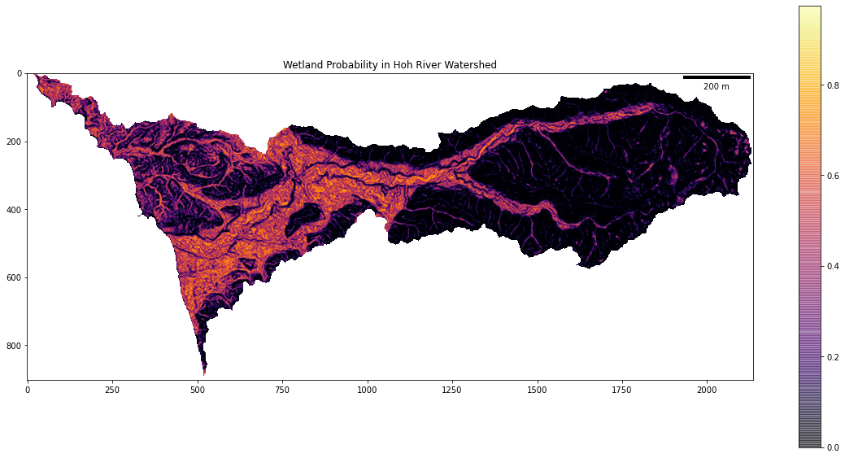
Methods – Generating Wetland Probability
Use some ArcGIS black magic
Makes topography metrics
Water flow routing
Random Forest
https://github.com/DanMillerM2/ForestedWetlands
Wetland Intrinsic Probability = WIP

Slide 7
Methods – Back to Python
Import more raster data layers
Topographic Wetness Index
Contributing Catchment Area
Slope
Import Carbon point data as geodataframe
Sample each raster (WIP, TWI, CatArea, Slp) with Rasterio and attach to geodataframe
Analyze with Multiple Linear Regression
Multiply coefficients by corresponding rasters

Slide 8
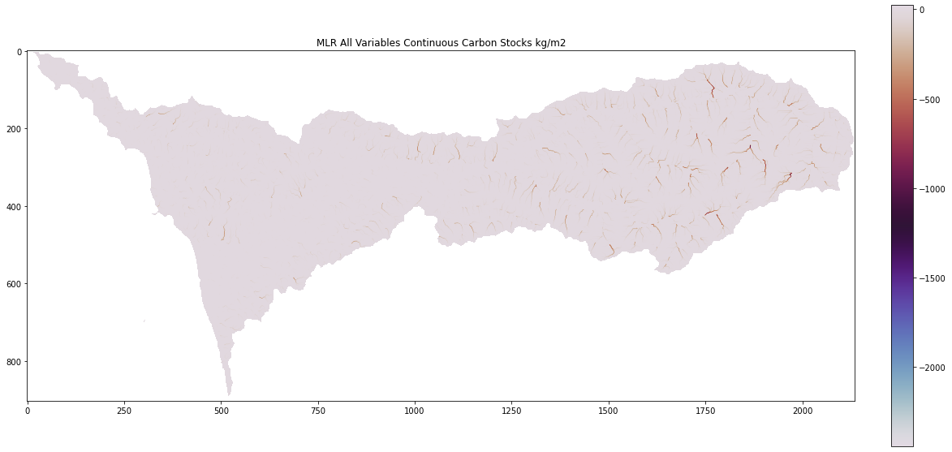
Results – What?
All Variables Sampled (WIP, TWI, CatArea, Slp)
KgC/m²
wip, catarea, twi, slp, intercept = [-5.6060e+00 -1.5000e-02 4.2390e+00 4.3230e+00 -2.2714e+01]

Slide 9
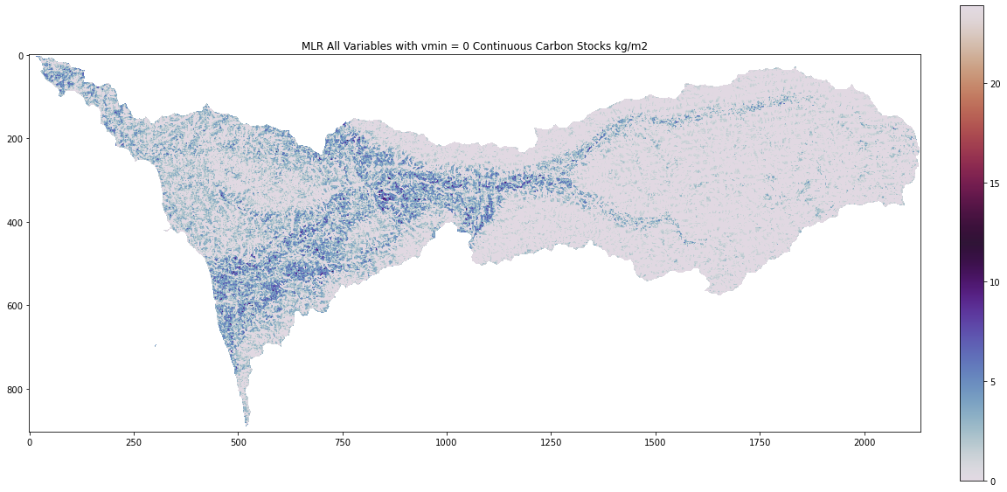
Results- Better?
All Variables with vmin = 0
KgC/m²
np.nansum(MLR[MLR>0]) = 1,050,141.1 KgC

Slide 10
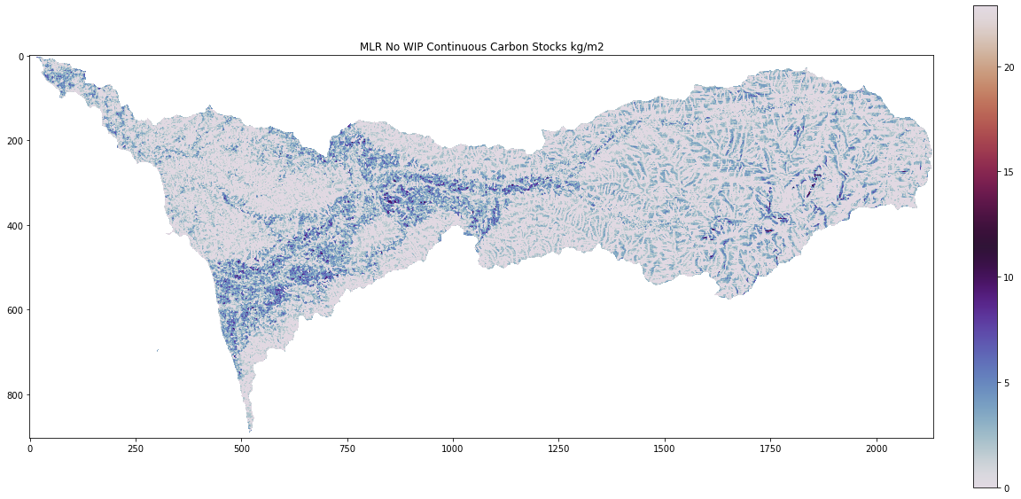
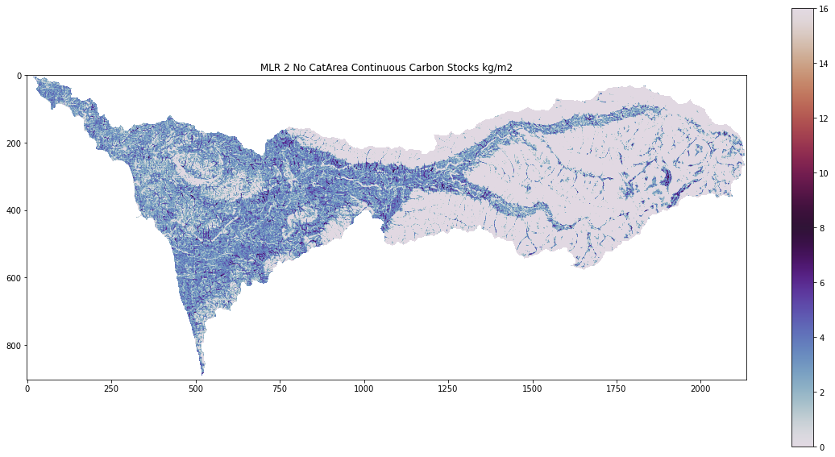
Results Even Better?
No WIP
KgC/m²
No CatArea
KgC/m²

Slide 11
Discussion
Changes to make things better
Use rioxarray instead of rasterio
Use alternative raster sampling methods
Figure out better relationships with catchment area
Include water features such as rivers, mountains to mask out potential areas

